Slide 1

Exploring Masculinities
Humanities Elective
Spring 2023
Module 1
Vindhya Undurti
(Former) Professor of Psychology
Tata Institute of Social Sciences Hyderabad campus

Slide 2
What made you opt for this course?
What are the words that come to your mind when you hear ‘masculinity’?
Warming
up

Slide 3
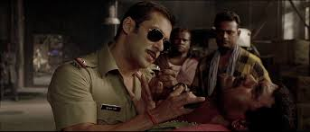
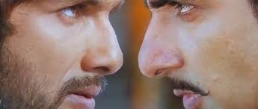
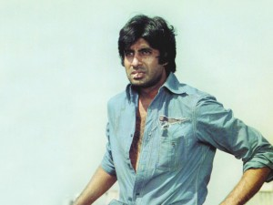
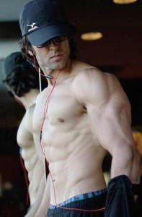
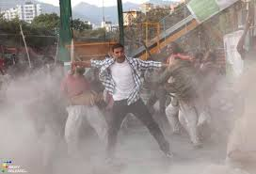
And what comes to your mind when you see these images?

Slide 4
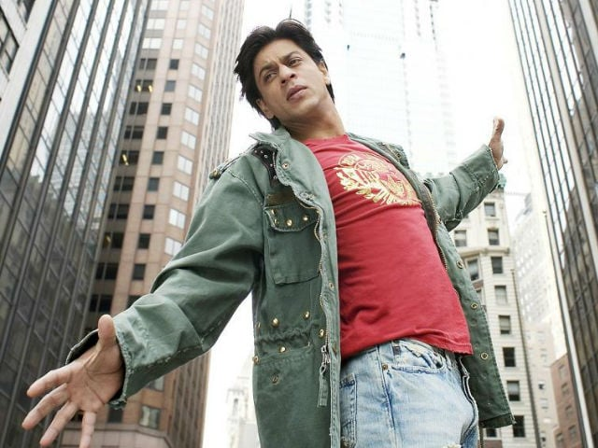
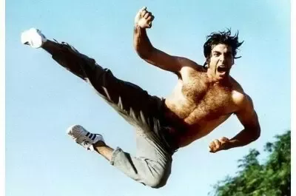
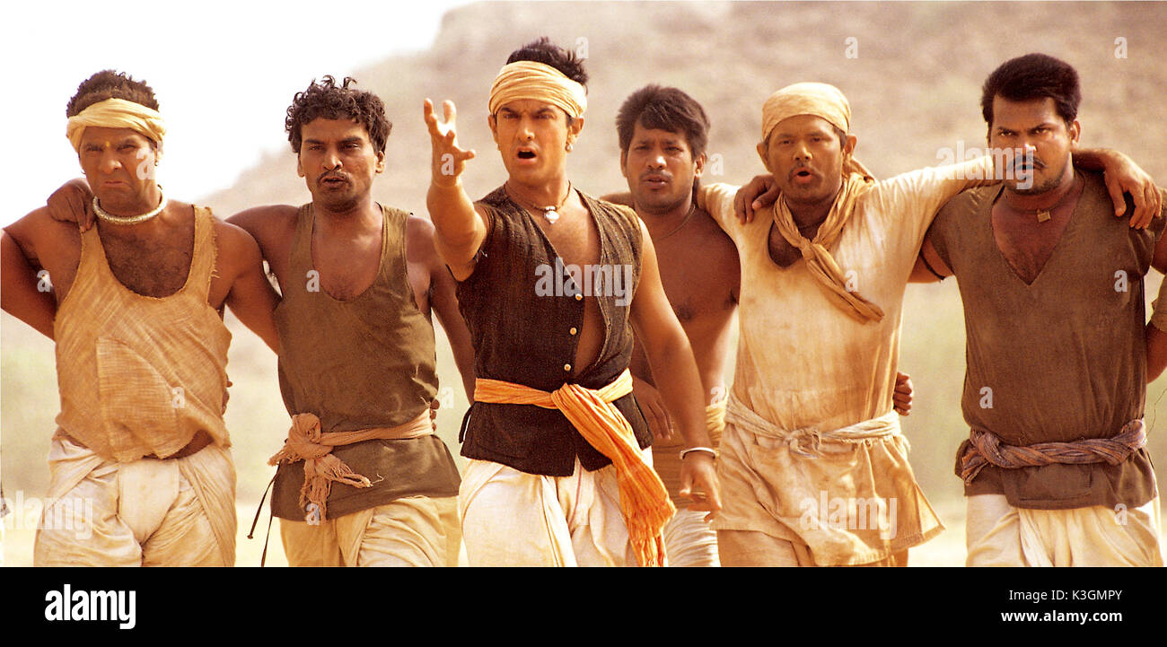
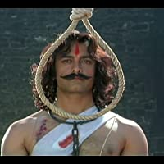
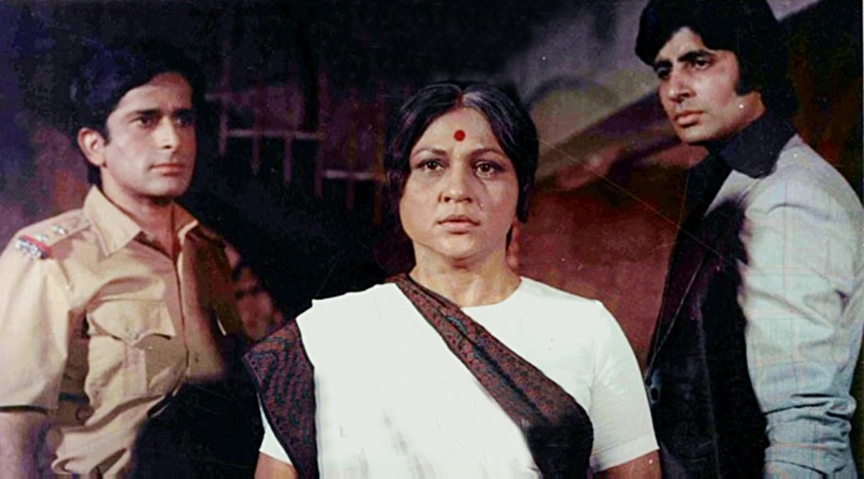
Bollywood masculinity a few years ago
The omnipresent romantic
Action hero – vanquishes enemies
Strong relationship to Mother
Fights for a cause
Leader & motivator
Symbol of aspirations, hopes, dreams

Slide 5
And can you think of a striking image of depiction of masculinity in current Bollywood or any other Indian language cinema?

Slide 6
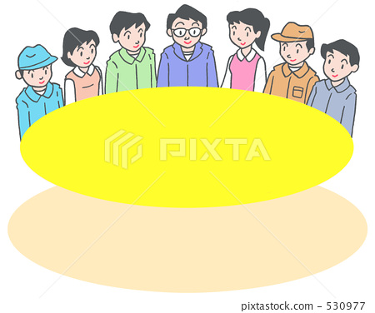
Group activity: 15 mins.
Form 5 groups
Discuss in the group about the possible advantages (individual and social) that you think a man has in society.
Discuss also the possible limitations that you think a man has in society
List them out
After the listing, a representative from the group can read them out.

Slide 7
What is this course about?
Module 1: Why study masculinities? Historical and scholarly interest in social sciences
Module 2: Social construction of masculinities, gender stereotypes and sexism
Module 3: Links between masculinities and violence; towards transformative masculinities

Slide 8
What does the course aim to do?
Helps to develop an understanding of how masculinity is constructed, and what have been its advantages and costs
Enables to apply the knowledge gained to your own life

Slide 9
What the course is NOT
Anti-male
DEFINITELY NOT!
Promoting hatred and anger against men
DEFINITELY NOT!

Slide 10
A1. Either a quiz or short essay/reflective piece [Word length 500-600 words] A2. Oral presentation (10-12 mins. duration) in pairs – Semester-end a. Collect at least 2 commercials (print/TV) that have man or men predominantly in focus b. Make a brief presentation using a ppt with the following in mind: c. In each advt point out how the male figure and gender relations are being depicted d. Use significance of the following details to further your analysis: - activity - setting and other objects or people pictured - clothing - posture - other attributes of identity, including class, sexual orientation, age - content of the written text - any background narrative Use concepts learnt in class in your analysis
Assessments (2)

